Slide 1


“Job Search Platform”
Submitted by :Manasi Kulkani
Submission type : Individual
Name: Manasi Kulkani
Batch : WOB B1
LMS Id :MGSA_061
Program : Axis Java
Date: DD/MM/YYYY

Slide 2

Table of contents
Introduction
Project Overview
Architecture Design
User Interface Design
Back-end Development
Front-end Development
Testing
Deployment
Conclusion
Future Work
References
Appendices

Slide 3
Introduction
project is to develops an online job search Portal for the Job Seeker
In this job portal different organizations ,Institutions ,Companies etc display or post jobs according to their requirements so that the job seekers view the different kind of jobs and the further information about the relative organization.
Jobseeker also apply for that jobs
organizations also check the information of job seekers if he or she fullfill the requirements of organizations with hire’s or contact them for the jobs

Slide 4
Project Overview
The purpose of designing the online job portal is to give the job seekers a platform for finding a right and a satisfactory job according to their qualification. It also connects the job seekers with the major organizations.
The scope of the online job portal includes :
The Online job Portal System that is to be developed provides the members with jobs information, online applying for jobs and many other facilities.
The basic scope of the project is given as under.
Employee/ Job seekers
Employee/ Recruiter

Slide 5
Project Overview
Following are the objectives that we wish to achieve with this project:
To provide a platform to the Job Seekers which will help them to get job as per their skills and requirements
To provide a better way to the Recruiters in order to hire employees with skills company needs.
To identify the needs of the Recruiters and Job Seekers with the help of numerous filters.

Slide 6
Architecture Design
User Interface: This component is responsible for handling user interactions with the system. It consists of web pages, forms, and other UI elements that allow users to input data, view information, and perform actions.
Application Logic: This component is responsible for processing user input and generating output. It contains the business logic that defines how the system operates and interacts with the user interface and database.
Database: This component stores all of the data that the system uses, including user profiles, booking information, and other relevant data. The database should be designed to support efficient storage and retrieval of data, as well as to ensure data consistency and security.
Web Server: This component is responsible for handling user requests and responses, as well as for managing communication between the user interface, application logic, and database. It should be designed to handle high traffic volumes and ensure system reliability and uptime.
Security: This component is responsible for ensuring the security of the system and its data.

Slide 7
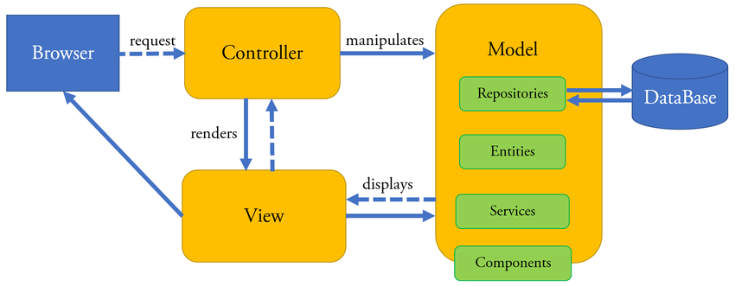
Architecture Design

Slide 8
Front-end Development
I have used html,css,bootstrap 5 and javascript for the frontend part
I have used html to structure the whole page which will be the skeleton of my page and all the positioning of the required tabs ,tables etc.
css will give the asthetic presence to the structure of the html make it look decent
Bootstrap will further help with the enhancement of the User Interface by giving user friendly
frontend and give certain functions without writing any javascript
javascript is the main technology which will give all the functions in web page , it is like the backbone of the front end
it will also communicate with controller of the spring to send data from the front end and give it back to it.

Slide 9
Back-end Development
Technology Used:
Platform : VS Code,Intellij
Back-end : - Java
- MySQL
FrameWork : - Spring boot

Slide 10
Deployment
RECRUITER MODULE:
This module provides functionalities for a Recruiter. Recruiters can post the vacancy details and can update them as and when necessary.
ADMIN MODULE:
This module provides all the Administrator related functionalities. Administrator manages entire application and maintains the profiles of Job Seekers and Recruiters.
JOB SEEKER MODULE:
This module provides functionalities for the job seekers. Applicants can post their Personal as well as Professional details. They will be able to submit a resume which can be accessed by the recruiters for hiring purposes.

Slide 11
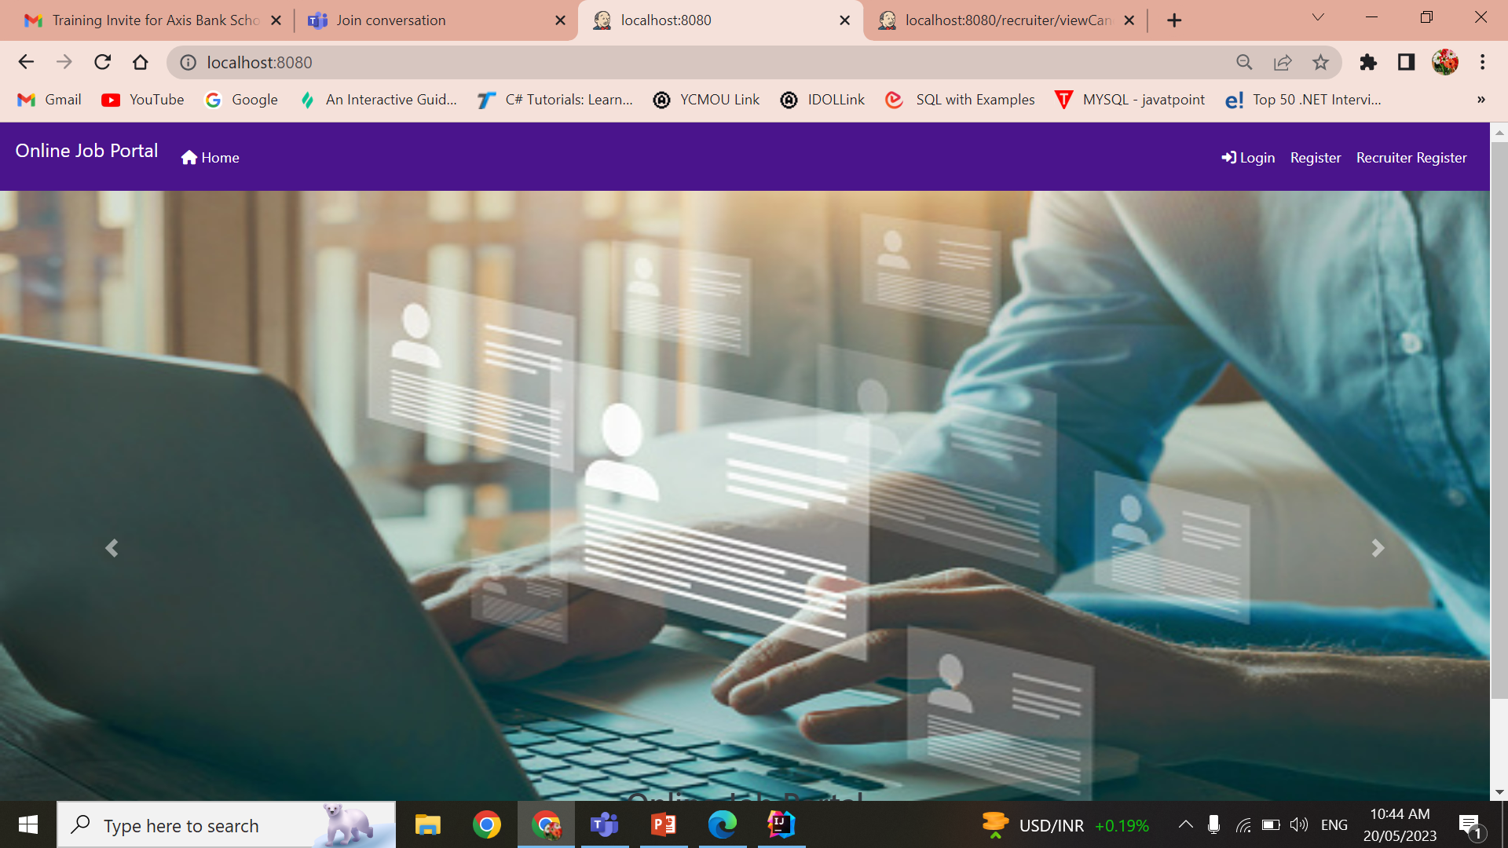
User Interface Design

Slide 12
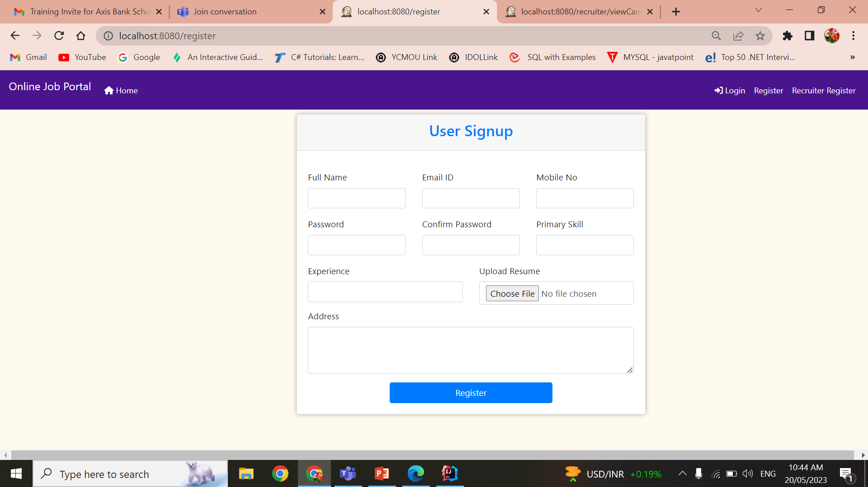
User Interface Design

Slide 13
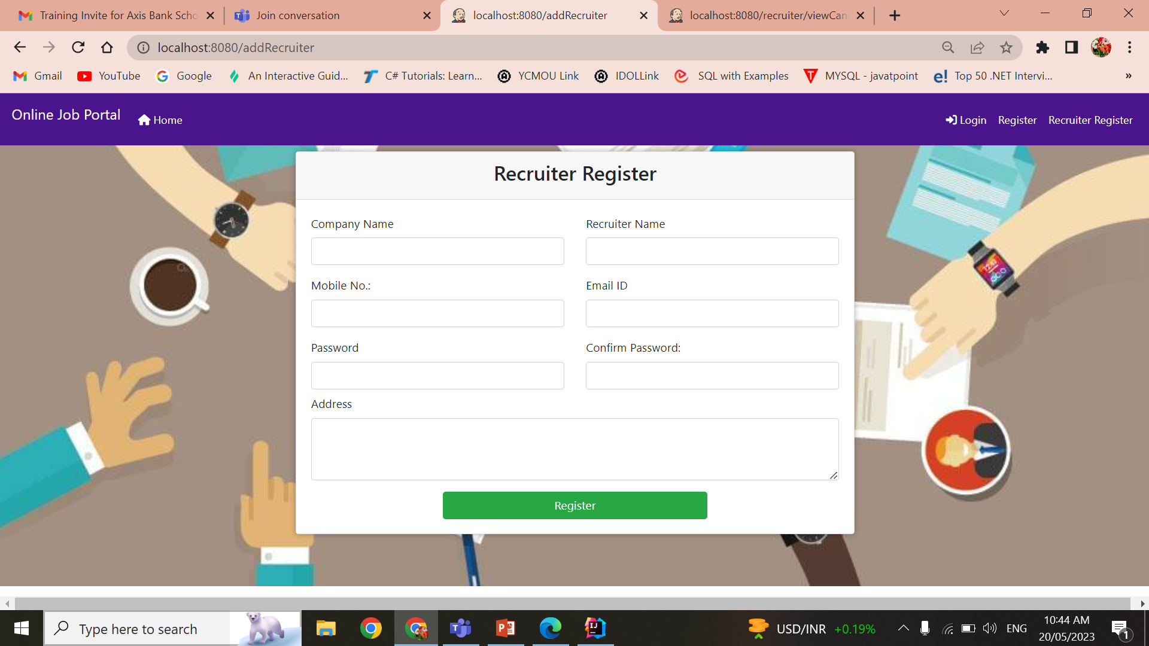
User Interface Design

Slide 14
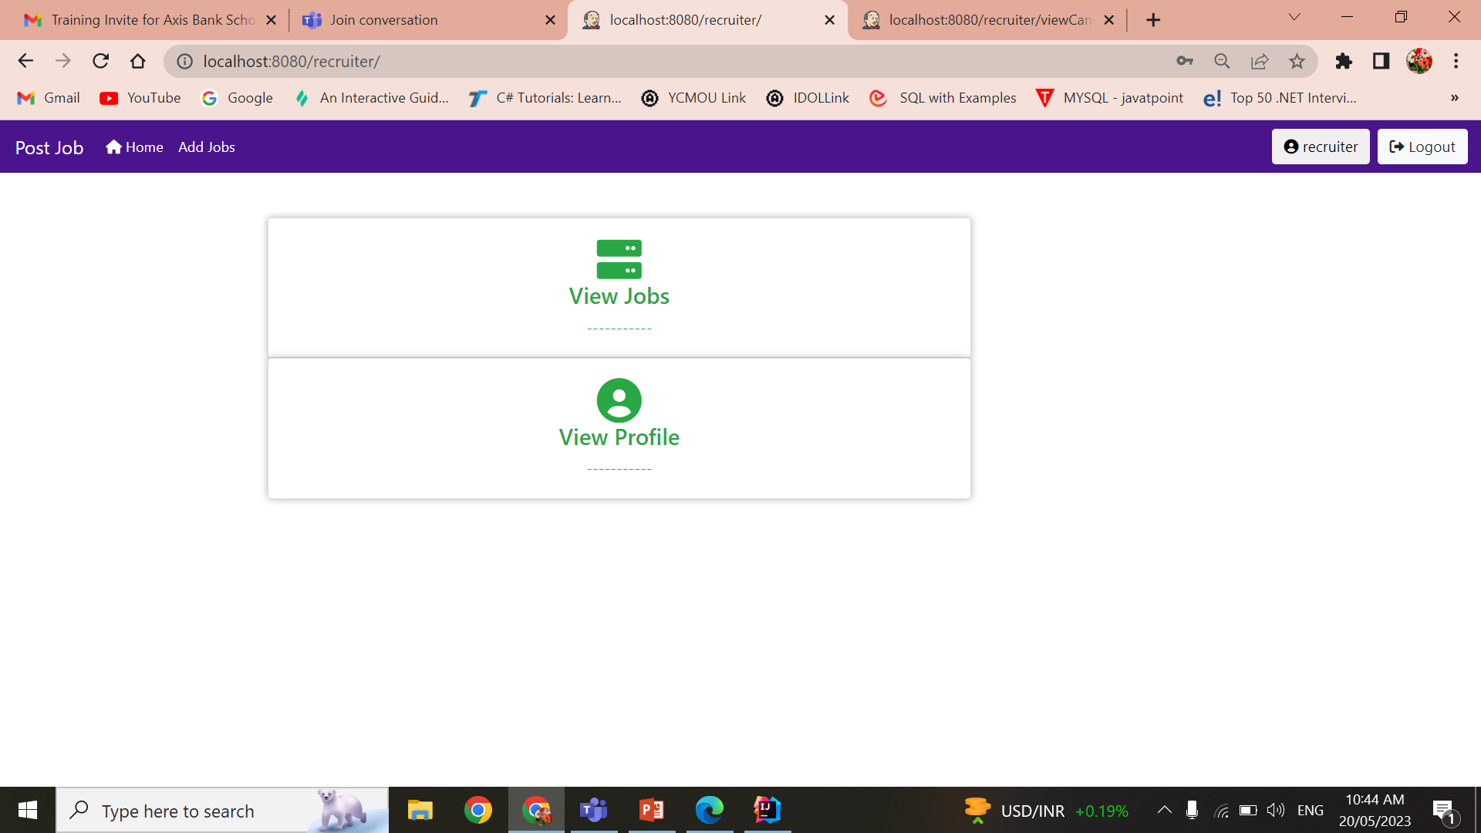
User Interface Design

Slide 15
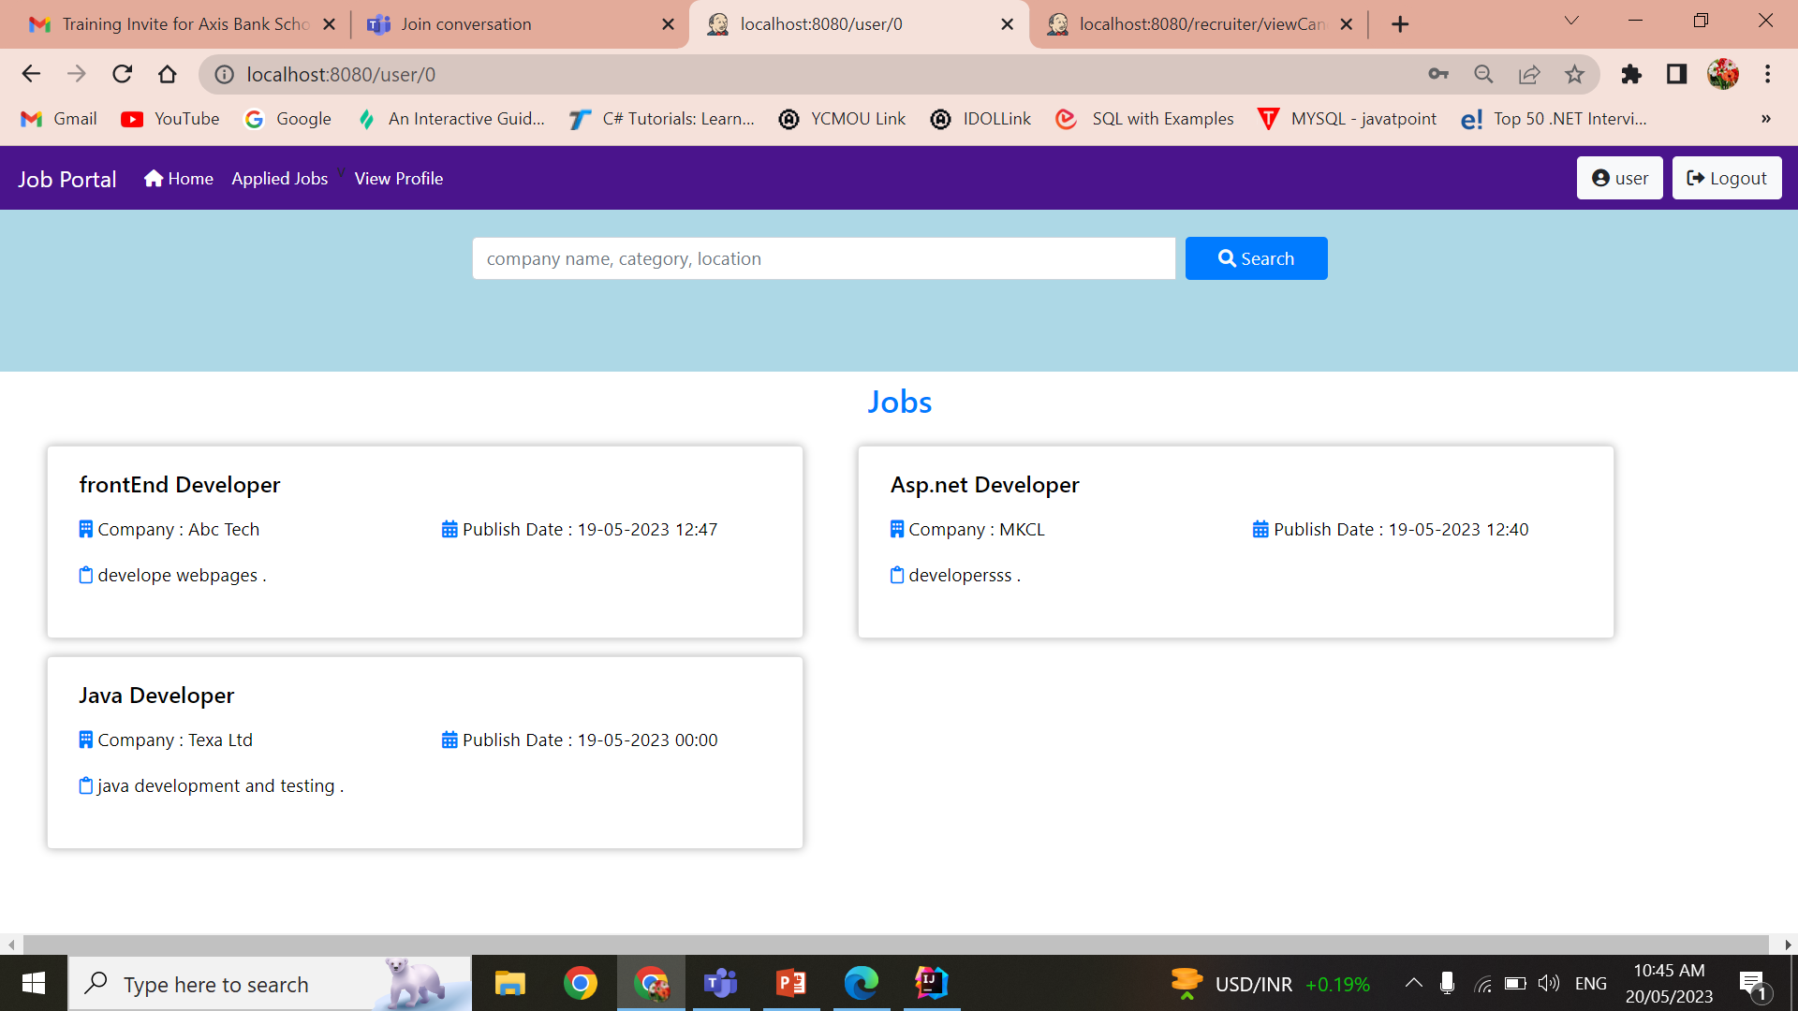
User Interface Design

Slide 16
Conclusion
A Job Portal provides an efficient search for online information on job vacancies for Job Seekers.
The main goal of this portal is to attempt to produce the right graduates based on the industry needs.

Slide 17
Future Work
As a job seeker, I want to be able to connect with recruiters through the platform so that I can network and learn about new job opportunities.
As a recruiter, I want to be able to search for potential candidates based on their qualifications and experience.

Slide 18
References
https://getbootstrap.com/docs/5.3/getting-started/introduction/
https://www.w3schools.com/bootstrap/bootstrap_get_started.asp
https://spring.io/guides/gs/spring-boot/
https://www.javatpoint.com/spring-mvc-tutorial

Slide 19
Appendices
This section includes any additional materials that support the project, such as screenshots, code snippets, or diagrams.

